Slide 1
The relationship of Interdisciplinarity, Entity Features and Clinical Translation Potential of COVID-19 Papers
Joint Workshop of the 4th Extraction and Evaluation of Knowledge Entities from Scientific Documents (EEKE2023) and the 3rd AI + Informetrics (AII2023)
Shuang Chen
School of Health Management
China Medical University
shuangchen1212@163.com
Chunli Liu*
Library, China Medical University
liuchunliliangxu@163.com
Corresponding author

Slide 2
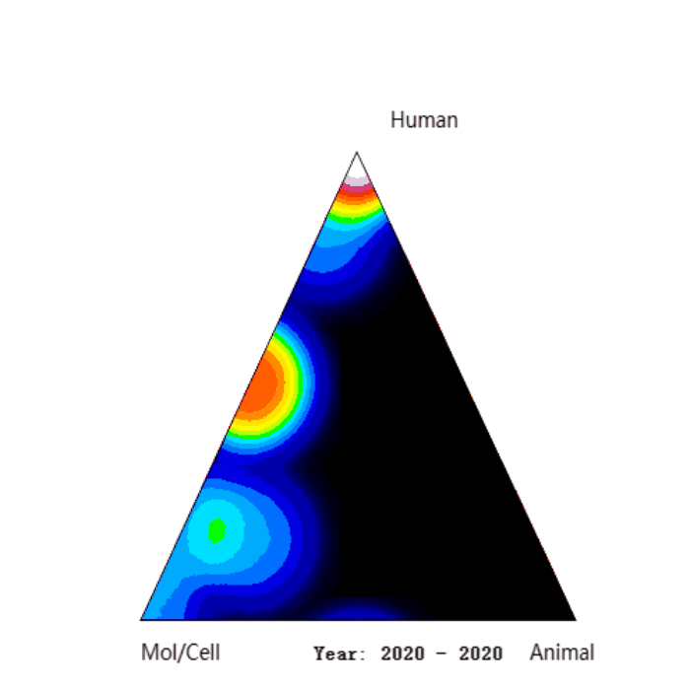
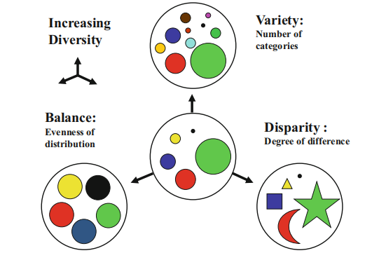
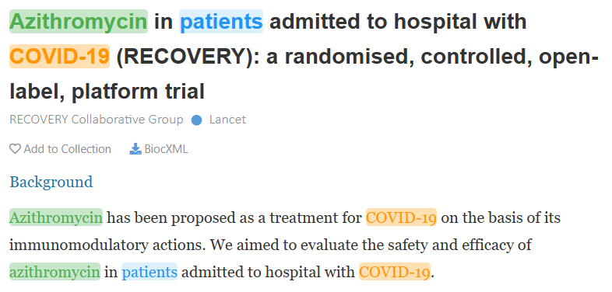
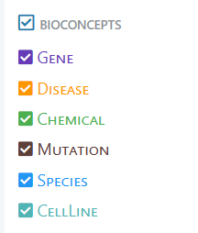

1 Introduction
Biomedical research has academic impact & clinical impact
The exploration of scientific impact evaluation has been very rich, but the identification and measurement of clinical impact
is still relatively weak.
Clinical translation Interdisciplinary research Biological entity features
Source:iCite
Source: Rafols and Meyer (2010)
Source: Pubtator
Objectives
1) to measure the clinical translation intensity of COVID-19 articles published in 2021.
2) to measure the correlation between clinical translation intensity, interdisciplinarity, and entity features.
Rafols, I. (2014). Knowledge Integration and Diffusion: Measures and Mapping of Diversity and Coherence. In: Ding, Y., Rousseau, R., Wolfram, D. (eds) Measuring Scholarly Impact. Springer, Cham

Slide 3



2 Related works
The measurement of clinical translation intensity
From the perspective of research area
From the perspective of MeSH terms
From the perspective of citing paper：citations in secondary documents/clinical guidelines/clinical trials
From the perspective of entities
Neural network models with multiple perspectives
The measurement of interdisciplinary
Diversity :Variety, Balance and Disparity
Coherence:density, intensity and Disparity
Entitymetrics
Mentions of knowledge entities in papers
Inter-entity co-occurrence network
Entity-citation-entity network
Content novelty of scientific papers
The relationship between entity characteristics and the impact of papers

Slide 4
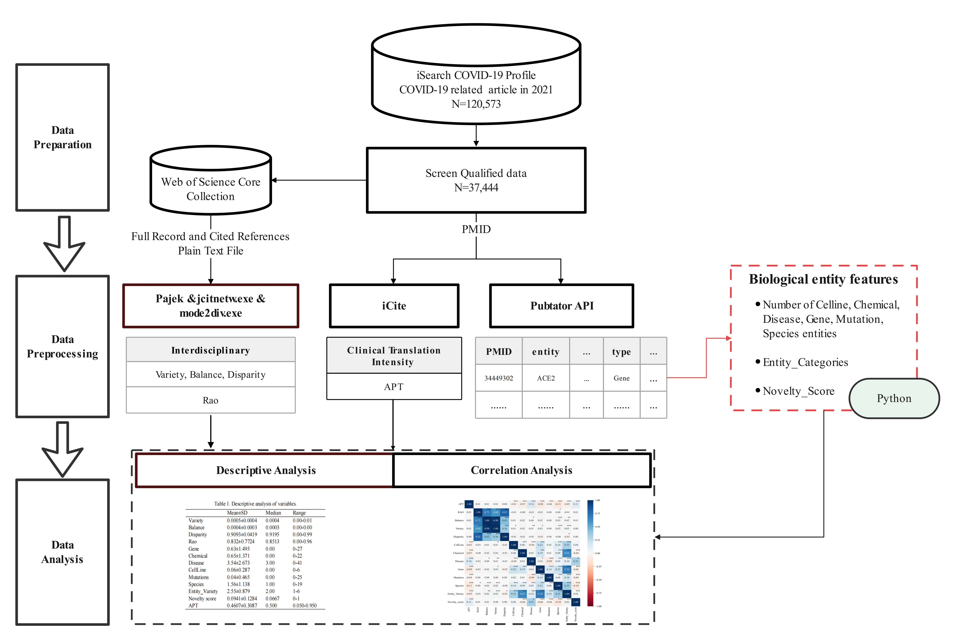
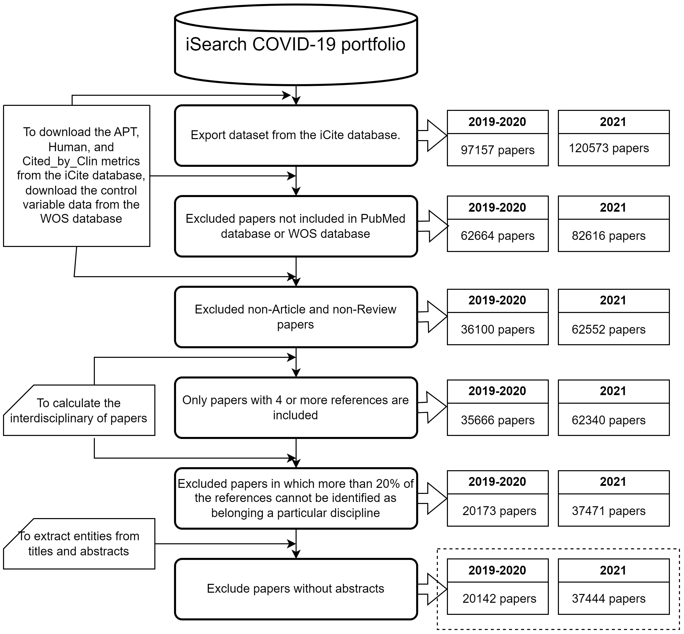
3 Methods——Frame
Research flow chart
Inclusion and exclusion criteria
https://icite.od.nih.gov/covid19/search/
https://www.leydesdorff.net/software/interdisc/
PubTator Central - NCBI - NLM - NIH

Slide 5
3 Methods——Frame
Dependent variables
APT (Approximate Potential to Translate)
Independent variables
Interdisciplinary
Variety, Balance, Disparity, RAO
Biological entity features
Gene, Chemical, Disease, CellLine, Mutations, Species
Entity_Variety
Novelty score
Research flow chart

Slide 6
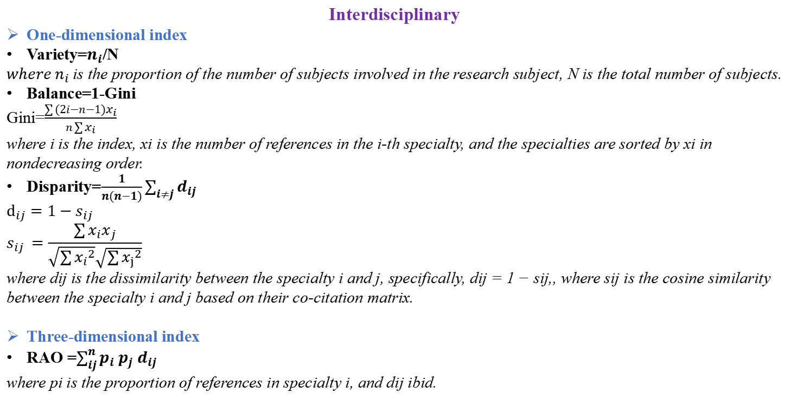
3 Methods——Independent variables
Interdisciplinary
One-dimensional index
Variety=$n_{i}$/N
${where n}_{i}$is the proportion of the number of subjects involved in the research subject, N is the total number of subjects.
Balance=1-Gini
Gini=$\frac{\sum{(2i−n−1)x_{i}}}{n\sum{x_{i}}}$
where i is the index, xi is the number of references in the i-th specialty, and the specialties are sorted by xi in nondecreasing order.
Disparity=$\frac{1}{n(n−1)}\sum_{i≠j}{d_{ij}}$
$$d_{ij}=1−s_{ij}$$
$$s_{ij }=\frac{\sum{x_{i}x_{j}}}{\sqrt{\sum{{x_{i}}^{2}}}\sqrt{\sum{{x_{j}}^{2}}}}$$
where dij is the dissimilarity between the specialty i and j, specifically, dij = 1 − sij,, where sij is the cosine similarity between the specialty i and j based on their co-citation matrix.
Three-dimensional index
RAO =$\sum_{ij}^{n}{p_{i}}$ $p_{j}$ $d_{ij}$
where pi is the proportion of references in specialty i, and dij ibid.

Slide 7
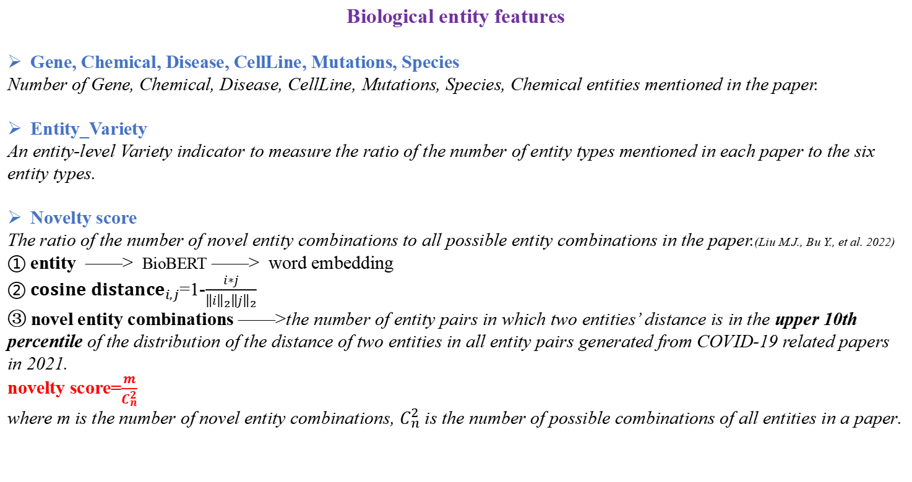
3 Methods——Independent variables
Biological entity features
Gene, Chemical, Disease, CellLine, Mutations, Species
Number of Gene, Chemical, Disease, CellLine, Mutations, Species, Chemical entities mentioned in the paper.
Entity_Variety
An entity-level Variety indicator to measure the ratio of the number of entity types mentioned in each paper to the six entity types.
Novelty score
The ratio of the number of novel entity combinations to all possible entity combinations in the paper.(Liu M.J., Bu Y., et al. 2022)
① entity ——> BioBERT ——> word embedding
② ${cosine distance}_{i,j}$=1-$\frac{i∗j}{{\left\|i\right\|}_{2}{\left\|j\right\|}_{2}}$
③ novel entity combinations ——>the number of entity pairs in which two entities’ distance is in the upper 10th percentile of the distribution of the distance of two entities in all entity pairs generated from COVID-19 related papers in 2021.
novelty score=$\frac{m}{C_{n}^{2}}$
where m is the number of novel entity combinations, $C_{n}^{2}$ is the number of possible combinations of all entities in a paper.
Liu M.J., Bu Y., et al. 2022. Pandemics are catalysts of scientific novelty: Evidence from COVID-19. Journal of the Association for Information Science and Technology, 73(8), 1065-1078. https://doi.org/10.1002/asi.24612

Slide 8
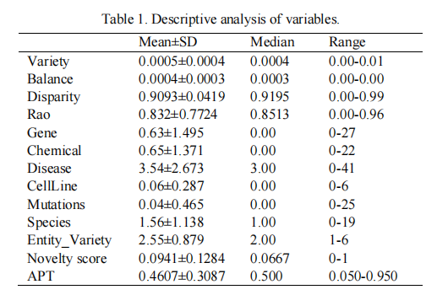
4 Results——Descriptive analysis of variables

Slide 9
4 Results——Correlation between independents and dependents
Interdisciplinary and APT
APT was not correlated with RAO, Balance, Variety and Disparity, showing no statistical significance (p﹥0.05)
Entity Feature and APT
(Negative)The more CellLine, Chemical, Gene, Mutation and Species entities mentioned in each paper, the smaller the APT of the paper.
(Positive)The more Disease entities mentioned in each paper, the greater the APT of the paper.
(Negative)APT is negatively correlated with the number of entity types (β= - 0.048, p﹤0.01).
(Positive)APT was positively correlated with novelty score (β= 0.105, p﹤0.01).
Figure 1. Correlation of APT, interdisciplinarity and entity feature

Slide 10
5 Conclusion
Close to half of this collection of papers studying COVID-19 will transfer the knowledge in the papers to clinical practice.
Average COVID-19 paper published in 2021 has a 46.07% clinical translation probability.
APT for COVID-19 papers was not associated with interdisciplinarity.
It may be due to the calculation method of interdisciplinary index.
In terms of revealing the content of a paper, the traditional interdisciplinary index is far less fine-grained than the knowledge entity features mentioned in the paper.
The entity-related indicators of COVID-19 papers was correlated with the clinical translational potential of the paper.
Negative:CellLine, Chemical, Gene, Mutation and Species
the number of entity types
Positive:Disease
novelty score

Slide 11
Thank you for your attention！
Joint Workshop of the 4th Extraction and Evaluation of Knowledge Entities from Scientific Documents (EEKE2023) and the 3rd AI + Informetrics (AII2023)
Shuang Chen
School of Health Management
China Medical University
shuangchen1212@163.com
Chunli Liu*
Library, China Medical University
liuchunliliangxu@163.com
Corresponding author

